Slide 1

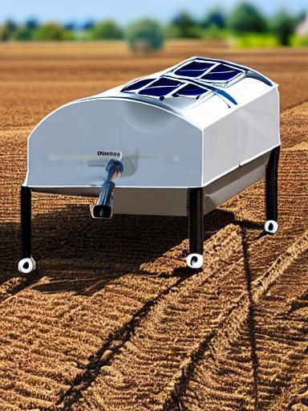
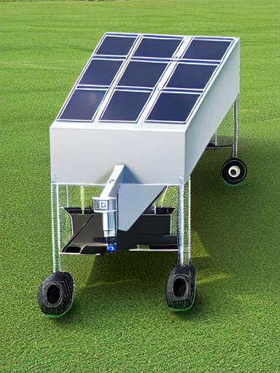
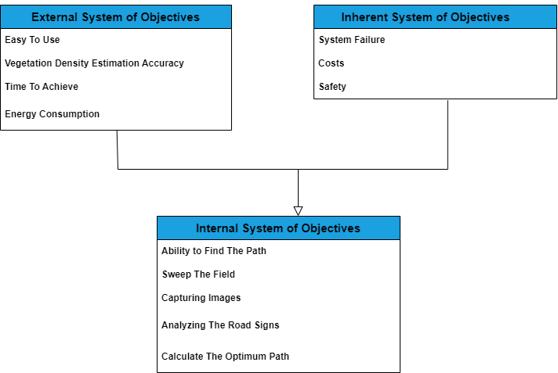
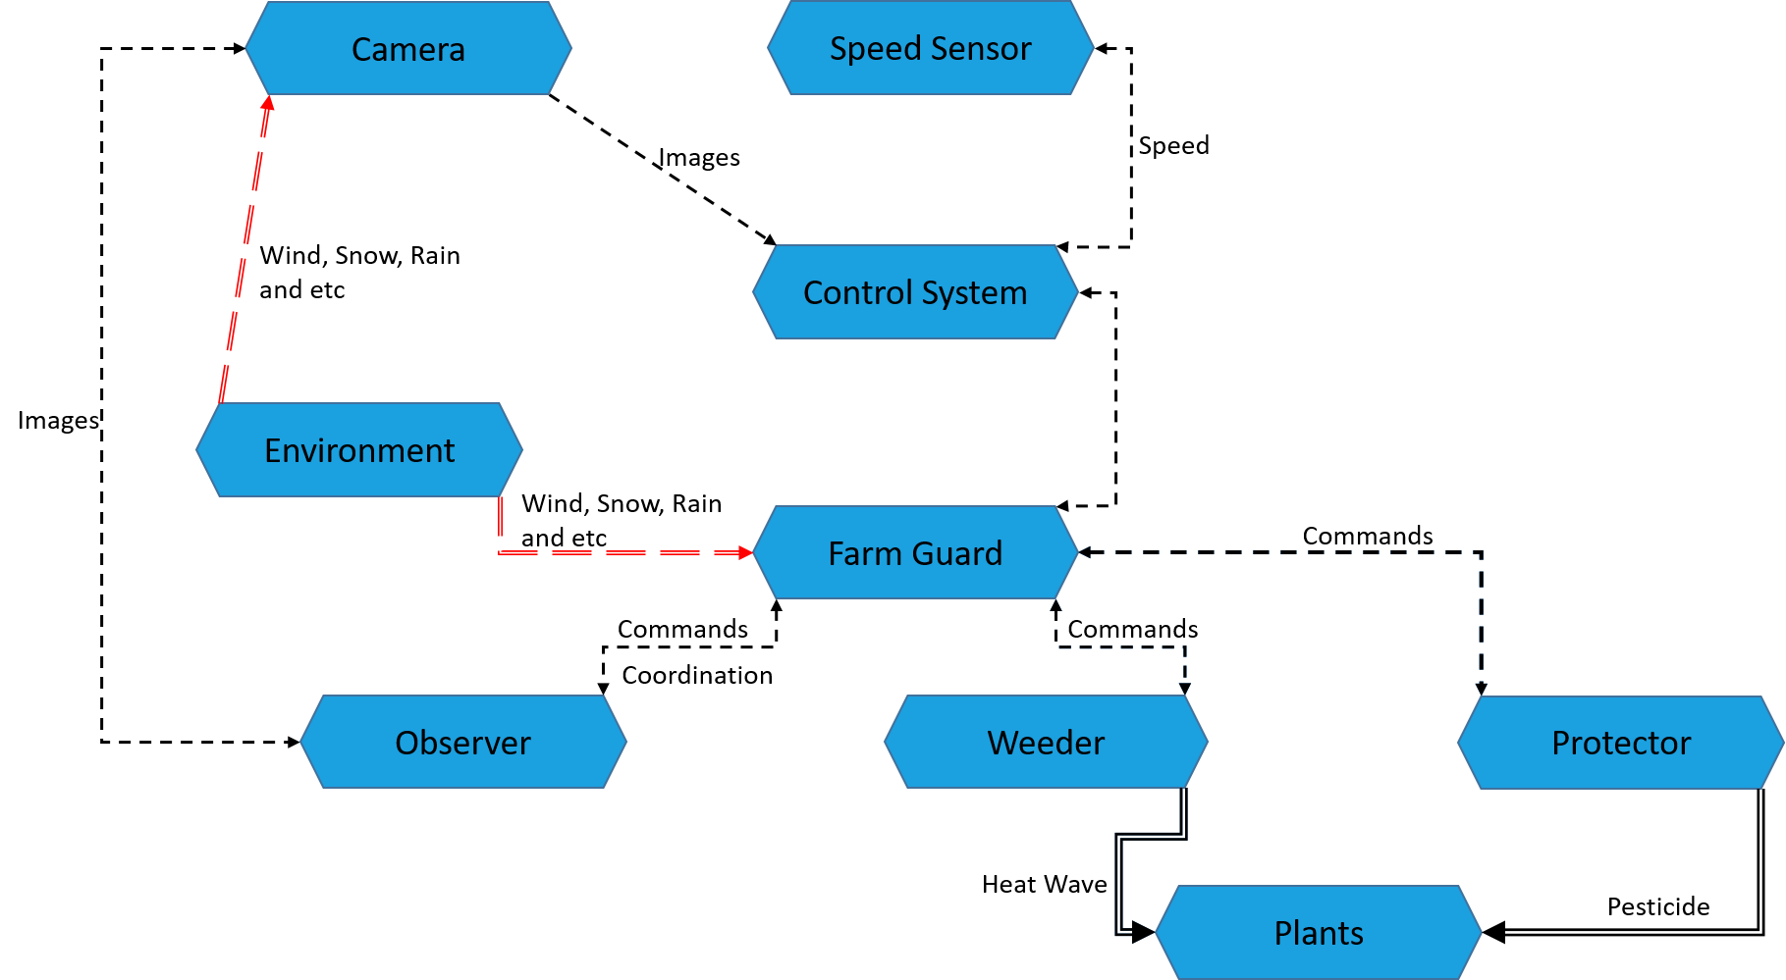
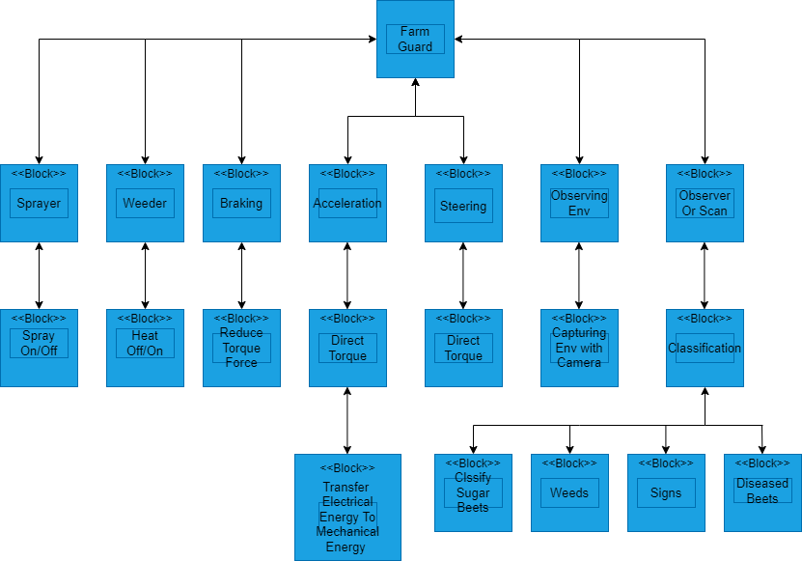
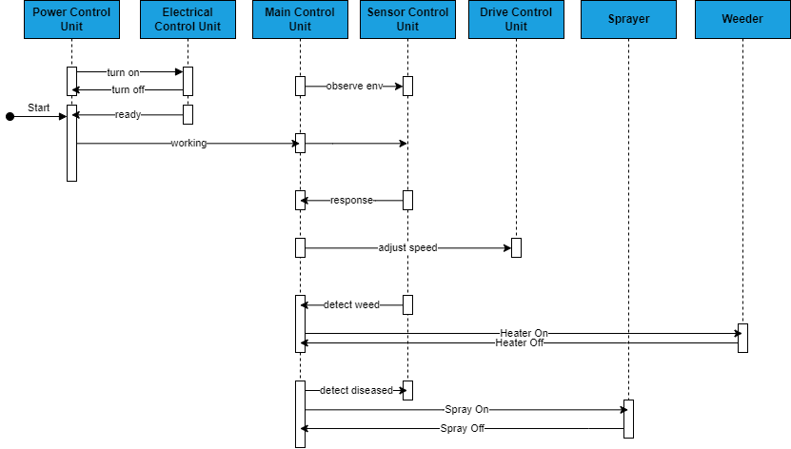

Group 3
Tao Zhao
Ali Beiti Aydenlou
Ferhad Gulizada
Negin Amiri
Danial Rafiee
Farm Guard
Consens Model
Summer School
Embedded Systems Engineering
System Design
3 in 1 agriculture AV for Detection and removal of the weeds and pesticides spray on unhealthy plants
Equipped with a camera to capture the field
Battery and solar panel on top
Steering system pesticides tank, and a heater to kill weeds
Approximate 80 centimeters height with high legs to go above the plants in a farm
Technical Matters
Requirements
Application Scenario
Environmental Model
System of Objectives
Behavior Model
Functions

